Slide 1
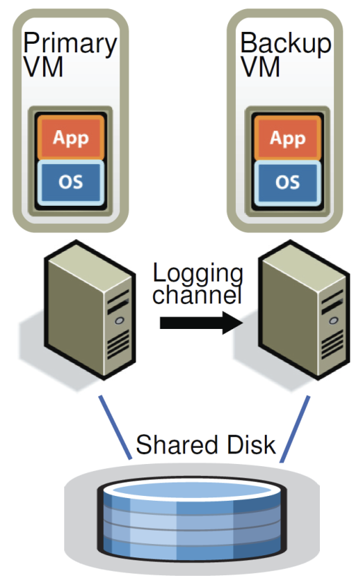
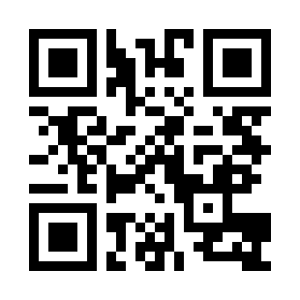
Lab 02 - Replication
https://bit.ly/47knOEq

